Slide 1
Retrieving Data from TWO or MORE Tables
Chapter 4

Slide 2
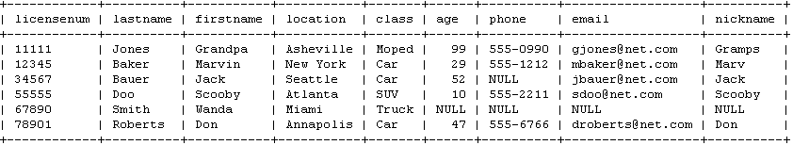
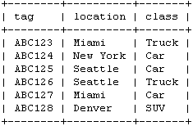
ABC Corporation (misc database)
Drivers Table
Vehicles Table

Slide 3
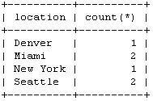

Query ABC Corporation Tables
Which drivers are located in New York?
SELECT * from drivers WHERE location = ‘New York’;
How many cars are in each city?
SELECT location, COUNT(*) from vehicles GROUP BY location;
Which drivers assigned to drive trucks are located in Miami?
SELECT firstname, lastname from drivers
WHERE location = ‘Miami’ AND class = ‘Truck’;
Which drivers assigned to drive trucks are located in New York?
SELECT firstname, lastname from drivers WHERE location = ‘New York’ AND class = ‘Truck’;

Slide 4
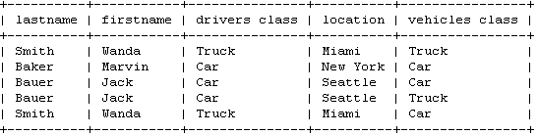
Query ABC Corporation Tables
List all of the vehicle/driver pairings possible without relocating a vehicle or driver
SELECT lastname, firstname, drivers.class AS 'drivers class',
drivers .location, vehicles.class AS 'vehicles class'
from drivers, vehicles
WHERE drivers.location = vehicles.location;
Problem?
Some drivers are in a city with vehicles that are not in the same class as they are allowed to drive.

Slide 5
INNER JOIN
Combining columns from two or more tables into a single result set base on join conditions
in this example join conditions could be: location and class
table can be joined using existing database relationships or ad hoc relationships
drivers
vehicles
SELECT select_list
FROM table_1 [INNER] JOIN table_2
ON join_condition;
SELECT select_list
FROM table_1, table_2
WHERE join_condition;

Slide 6
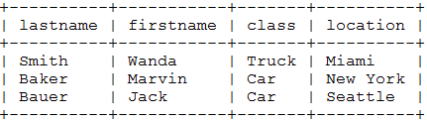
INNER JOIN SYNTAX (2 tables)
drivers
vehicles
SELECT lastname, firstname, vehicles.class, vehicles.location
FROM drivers inner join vehicles
ON drivers.location = vehicles.location
AND drivers.class = vehicles.class;
*explicit
SELECT lastname, firstname, vehicles.class, vehicles.location
FROM drivers, vehicles
WHERE drivers.location = vehicles.location
AND drivers.class = vehicles.class;
implicit
qualified column names

Slide 7
INNER JOIN SYNTAX (2 tables)
drivers
vehicles
SELECT lastname, firstname, v.class, v.location
FROM drivers d, vehicles v
WHERE d.location = v.location AND d.class = v.class;
table alias names
SELECT lastname, firstname, vehicles.class, vehicles.location
FROM drivers natural join vehicles;
SELECT lastname, firstname, v.class, v.location
FROM drivers d INNER JOIN vehicles v
USING (location, class);

Slide 8
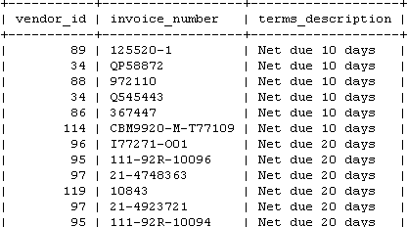
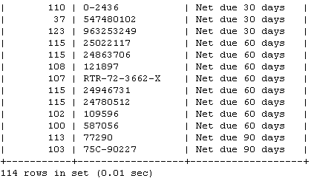
Let’s write an inner join query
List the vendor_id, invoice_number, terms_description for all invoices (invoices and terms tables)
select i.vendor_id, i.invoice_number, t.terms_description from invoices i join terms t where i.terms_id = t.terms_id;
select i.vendor_id, i.invoice_number, t.terms_description from invoices i natural join terms t;

Slide 9
LEFT JOIN
Combining all rows from a table with the intersecting rows of another table into a single result set base on join conditions
(in this example join conditions could be: location and class)
Drivers
Vehicles
SELECT select_list
FROM table_1 LEFT JOIN table_2
ON join_condition;

Slide 10
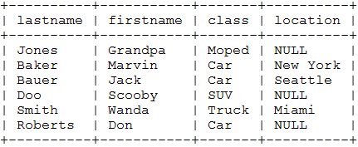
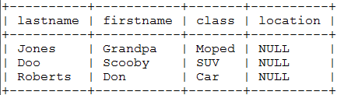
LEFT JOIN SYNTAX What about drivers who are in a city with no vehicle (stranded)?
Drivers
Vehicles
SELECT lastname, firstname, vehicles.class, vehicles.location
FROM drivers left join vehicles
ON drivers.class = vehicles.class and drivers.location = vehicles.location;
SELECT lastname, firstname, vehicles.class, vehicles.location
FROM drivers natural left join vehicles;
SELECT lastname, firstname, v.class, v.location
FROM drivers d natural left join vehicles v
WHERE v.location is null;

Slide 11
RIGHT JOIN
Combining all rows from a table with the intersecting rows of another table into a single result set base on join conditions
(in this example join conditions could be: location and class)
Drivers
Vehicles
SELECT select_list
FROM table_1 RIGHT JOIN table_2
ON join_condition;

Slide 12
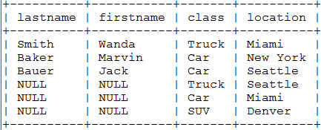
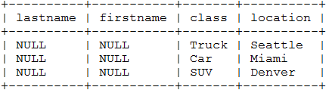
RIGHT JOIN SYNTAX What about vehicles who are in a city with no driver (stranded)?
Drivers
Vehicles
SELECT lastname, firstname, vehicles.class, vehicles.location
FROM drivers right join vehicles
ON drivers.class = vehicles.class and drivers.location = vehicles.location;
SELECT lastname, firstname, vehicles.class, vehicles.location
FROM drivers natural right join vehicles;
SELECT lastname, firstname, v.class, v.location
FROM drivers d natural right join vehicles v WHERE d.lastname is null;

Slide 13
UNION SYNTAX What about vehicles who are in a city with no driver AND drivers who are in a city with no vehicle (all stranded assets)?
UNION: Join 2 or more results sets from multiple tables together
same number of values
data types must correspond
Drivers
Vehicles
There is no outer join in MySQL; so you have to union a left join and a right join.

Slide 14
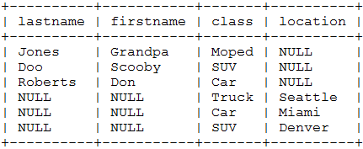
SELECT lastname, firstname, v.class, v.location
FROM drivers d natural left join vehicles v
WHERE v.location is null;
+
SELECT lastname, firstname, v.class, v.location
FROM drivers d natural right join vehicles v WHERE d.lastname is null;
=
SELECT lastname, firstname, v.class, v.location
FROM drivers d natural left join vehicles v
WHERE v.location is null
UNION
SELECT lastname, firstname, v.class, v.location
FROM drivers d natural right join vehicles v WHERE d.lastname is null;

Slide 15
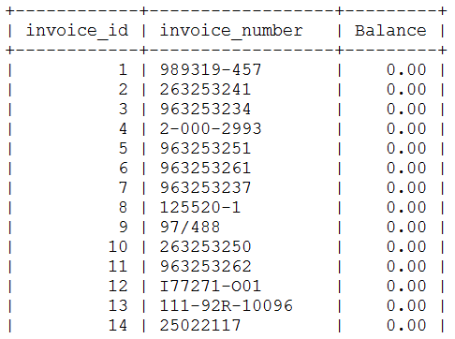
Let’s write a UNION query
List the invoice_id, invoice_number, balance for all invoices - showing the balance as “Paid” if 0 and the balance amount if > 0 in invoice_id sequence.
Balance = invoice_total – payment-total – credit_total
Step 1:
Show invoices with balance of 0
SELECT invoice_id, invoice_number,
invoice_total – payment_total – credit_total AS Balance
FROM invoices
WHERE invoice_total – payment_total – credit_total = 0;

Slide 16
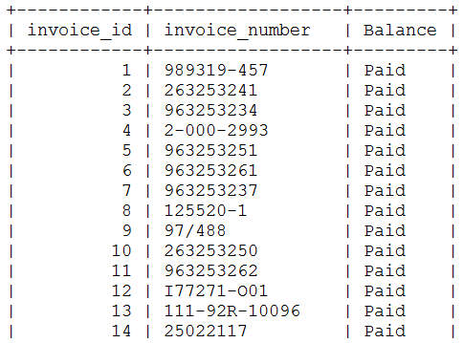
Let’s write a UNION query
List the invoice_id, invoice_number, balance for all invoices - showing the balance as “Paid” if 0 and the balance amount if > 0 in invoice_id sequence.
Balance = invoice_total – payment-total – credit_total
Step 2:
Replace Balance with “Paid”
SELECT invoice_id, invoice_number,
invoice_total – payment_total – credit_total ‘Paid’ AS Balance
FROM invoices
WHERE invoice_total – payment_total – credit_total = 0;

Slide 17
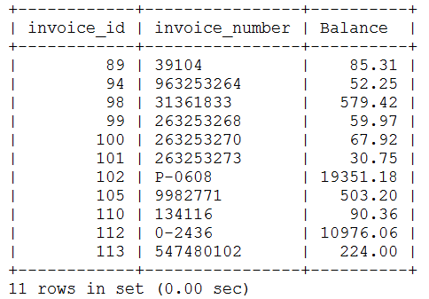
Let’s write a UNION query
List the invoice_id, invoice_number, balance for all invoices - showing the balance as “Paid” if 0 and the balance amount if > 0 in invoice_id sequence.
Balance = invoice_total – payment-total – credit_total
Step 3:
Show invoices with balance of > 0
SELECT invoice_id, invoice_number,
invoice_total – payment_total – credit_total AS Balance
FROM invoices
WHERE invoice_total – payment_total – credit_total > 0;

Slide 18
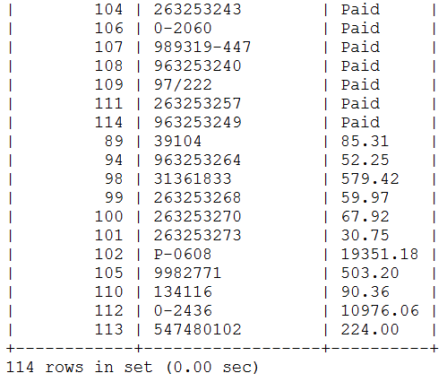
Let’s write a UNION query
List the invoice_id, invoice_number, balance for all invoices - showing the balance as “Paid” if 0 and the balance amount if > 0 in invoice_id sequence.
Balance = invoice_total – payment-total – credit_total
Step 4:
Join both SQL statements together for complete result set
SELECT invoice_id, invoice_number,
‘Paid’ AS Balance
FROM invoices
WHERE invoice_total – payment_total – credit_total = 0
UNION
SELECT invoice_id, invoice_number,
invoice_total – payment_total – credit_total AS Balance
FROM invoices
WHERE invoice_total – payment_total – credit_total > 0;

Slide 19
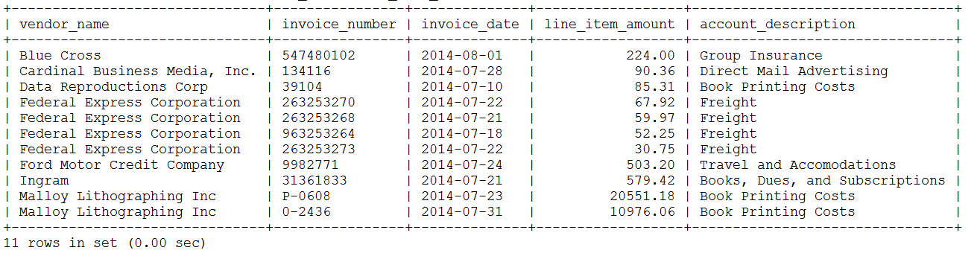
Join four tables
SELECT vendor_name, invoice_number, invoice_date, line_item_amount, account_description
FROM vendors v, invoices i, invoice_line_items li, general_ledger_accounts gl
WHERE v.vendor_id = i.vendor_id
AND i.invoice_id = li.invoice_id
AND li.account_number = gl.account_number
AND invoice_total - payment_total - credit_total > 0
ORDER BY vendor_name, line_item_amount DESC;

Slide 20
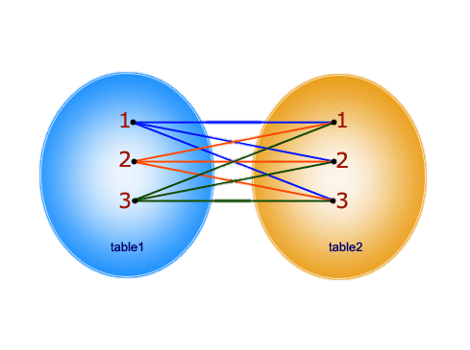
CROSS JOIN or Cartesian Product
Result set:
1, 1
1, 2
1, 3
2, 1
2, 2
2, 3
3, 1
3, 2
3, 3
Every row from 1st table joins with all rows of another table.
Result set will be number of rows in first table multiplied by number of rows in second table.
(in this example 3 x 3 = 9)

Slide 21
Drivers Table
Vehicles Table
How many rows would we expect in the result set of a CROSS JOIN between these two tables?

Slide 22
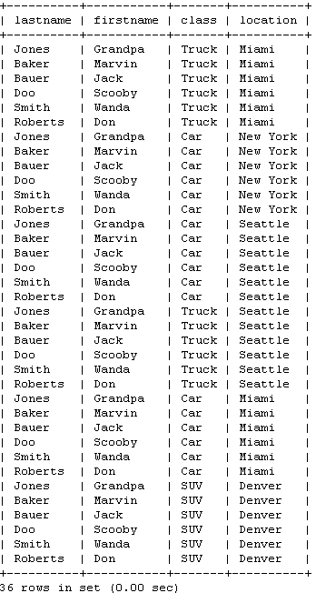
SELECT lastname, firstname,
v.class, v.location
FROM drivers CROSS JOIN vehicles v;

Slide 23


WHEW !!!!

